Slide 1

PRO HACKATHON
Elevator · 19-20 September, 2026
Notes:
Hoş geldiniz. Online cohort'un açılışı - bu iki hafta boyunca ne yapacağımızı anlatacağım.

Slide 2
PMF
In Turkey, people with savings hand money to "traders" on trust. A WhatsApp group, a screenshot of a winning month, a promise.
The saver has no custody, no proof and no way out. The trader who is genuinely good has no way to prove it — and the one who is not has no way of being caught.
Every part of this already happens. None of it is enforceable.
We are not inventing the behaviour. We are giving it a contract.
Notes:
Tüm takvim tek ekranda: iki online oturum, ardından İstanbul'da residency ve hackathon.

Slide 3
The Solution
Capital that can be traded but never taken.
The saver publishes capital — and the money moves into a Soroban vault at that moment. A listing is public only because the money behind it is already locked.
A trader takes the mandate. They swap inside the vault through an allow-listed router. They cannot withdraw — not once, not ever.
Every trade is bounded by a max-loss floor the contract enforces. A swap that would breach it is rejected on-chain, not flagged afterwards.
At settlement the contract splits by the agreed commission. On a loss, the trader earns nothing.
Notes:
Tüm takvim tek ekranda: iki online oturum, ardından İstanbul'da residency ve hackathon.

Slide 4
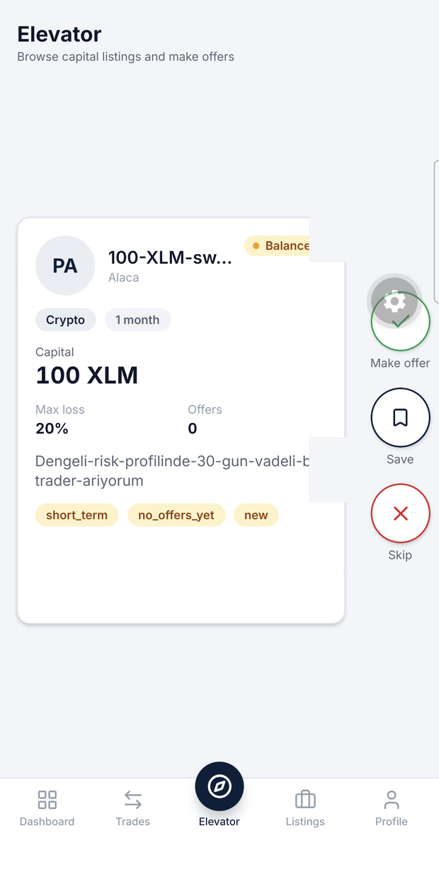
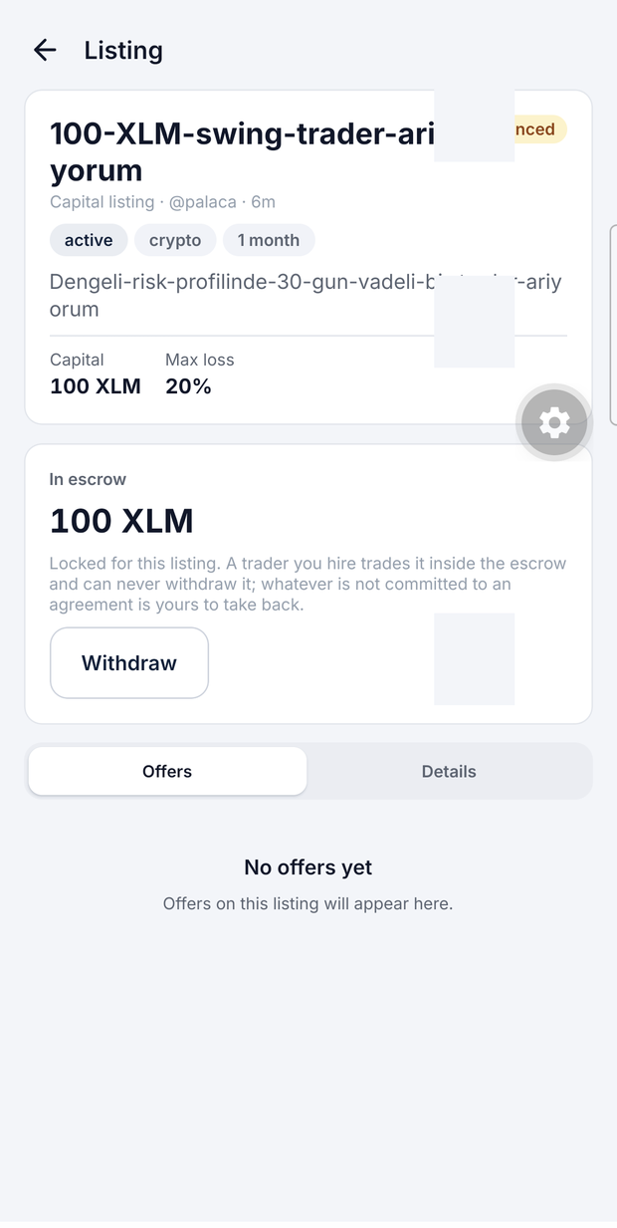
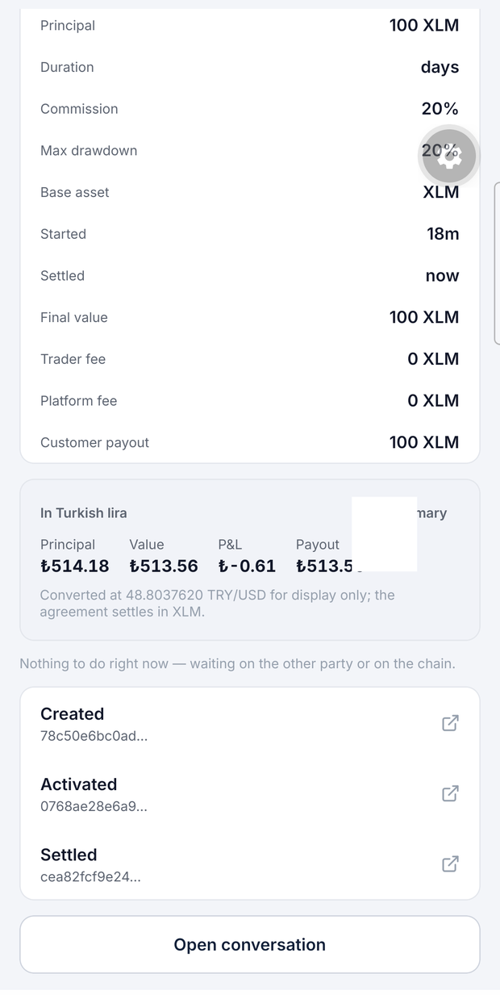
The Product
Swipe to find capital · the escrow shows what is actually locked · settlement is arithmetic, not a promise

Slide 5
How the escrow works
1 · Publish — the customer signs reserve. Capital leaves their wallet and sits in the vault.
2 · Agree — the trader offers, the customer accepts. open_reserved draws the principal from the reservation. The customer does not pay twice; their wallet is untouched.
3 · Trade — trade swaps inside the vault via Soroswap. The contract re-values the portfolio and rejects anything below the drawdown floor.
4 · Settle — everything is liquidated to the base asset, then split: commission, platform fee, customer payout.
A pause can never trap the money: release works while the contract is paused.

Slide 6
Technical Workflow
Expo / React Native → FastAPI → Soroban vault → Stellar
The server never holds a key. It builds an unsigned XDR, the wallet signs it, the app posts it back. Freighter over WalletConnect.
One singleton vault holds every agreement: reserve · open_reserved · accept · trade · settle · release. Persistent storage per agreement and per reservation, instance storage for config and the allow-list, TTL bumped on every write.
An indexer mirrors contract events into Postgres, so the app reads a database rather than the chain on every screen.
The trade-off: a backend that looks custodial and is not. One extra round trip per action buys a mobile app that never sees a secret key.
Notes:
Tüm takvim tek ekranda: iki online oturum, ardından İstanbul'da residency ve hackathon.

Slide 7
Stellar, end to end
Soroban — the vault is the product, not an add-on. Custody, drawdown enforcement and settlement maths all live on-chain. 47 contract tests pass.
SEP-6 — a real TRY ramp. Deposit 1,000 TRY → 20.3960908 USDC. Withdraw 10 USDC → 485.41 TRY. Both completed on testnet today. SEP-10 auth with the anchor, SEP-12 KYC, SEP-38 quotes.
Soroswap — every swap routes through the allow-listed router, with the quote and min_out written into the transaction the trader signs.
Horizon — market candles come from the mainnet order book. Testnet's book sits at a fake pegged rate and is useless for deciding a trade.

Slide 8
It works. Here is the chain.
Vault CCGAGVFFTH2IIH6WW2E52VVR5TJJFP3OL7HDZUZ2WQ7MT4Z57GA7NAG2 testnet · v1.2.0
One agreement, start to finish, on-chain today:
reserve 100 XLM locked at listing time
open_reserved customer paid 0.468 XLM of network fee — not 100 XLM again
accept active, 30-day term
trade 20 XLM → 3.9647321 USDC through Soroswap
settle 99.8801955 XLM to the customer, 0 commission — the run lost money
A second agreement is live at 160 XLM. The anchor moved TRY in both directions.
Nothing here is mocked.

Slide 9
What is next
Now — one anchor, one pair, testnet. The mechanic is proven; the surface is deliberately small.
Next — mainnet with a licensed TRY anchor, more pairs, and the piece we care about most: making a trader's track record portable. A rating and a settled history that belong to the person, not to us.
Then — passkeys and smart wallets, so a saver never sees a seed phrase.
Intended path: SCF.
The honest gap: we have not put this in front of savers outside the team yet. That is the first thing after the hackathon, not the last.

Slide 10
The Team
[ Bu slaytı siz doldurun ]
İsim — rol — en fazla üç satır
İsim — rol — en fazla üç satır
Şablon burada bir ekip fotoğrafı da istiyor.
Notes:
Tüm takvim tek ekranda: iki online oturum, ardından İstanbul'da residency ve hackathon.

